Slide 1
Calibration Steps for EF5
Ghana 1km

Slide 2
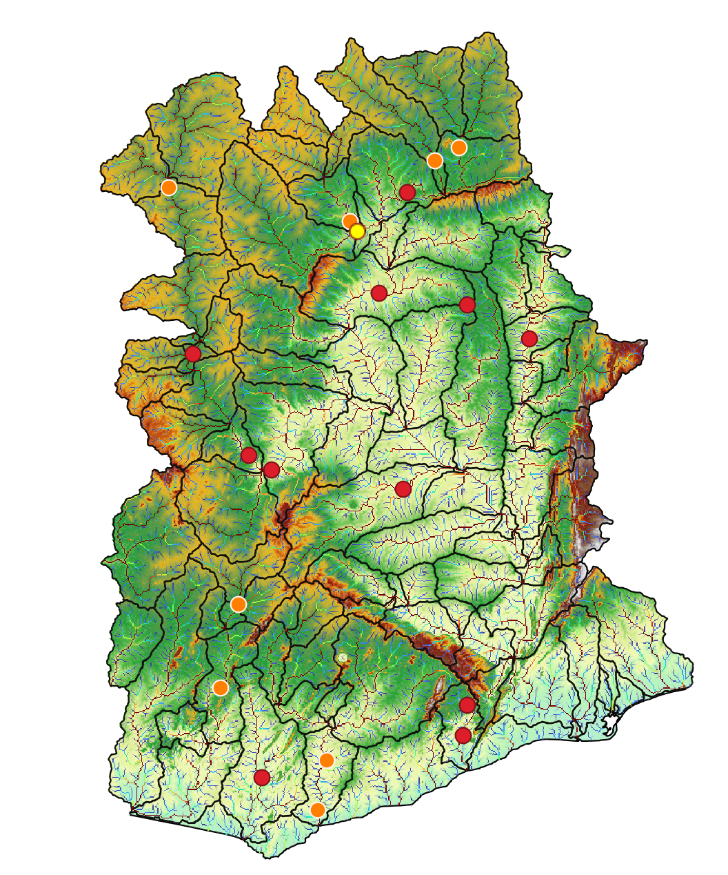
Gauge Selection (1531420)
Target Identification: Select the specific gauge for model calibration.
Selection Criteria: Prioritize gauges with high-quality observed data, focusing on:
Frequency: High temporal resolution (e.g., daily or hourly records).
Accuracy: Verified, error-free historical datasets.

Slide 3
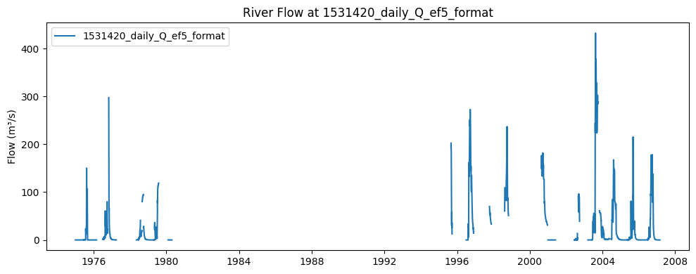
Selecting calibration period(1531420)
Plotting Tool: We use the obsPlot.ipynb Jupyter notebook to generate the visual plot of the observed data.
Period Selection: Based on the generated plot, we identify and select the most appropriate period for calibration.
Selected Window: The 2004–2008 period was chosen due to its continuous data availability.

Slide 4
Preparing EF5 Control File
Once the calibration period is selected, we configure the Control File . Key components include:
Gauge Block: Specifies the exact coordinates (Lat/Lon) for the station, make sure the guage point is at a stream flow pixel.
Target: [Gauge 1531420]
Basin Block: Links the specific gauge to the study area.
Definition: [Basin WestAfr]
Parameter Calibration Blocks: Define the search ranges for the DREAM algorithm.
CREST Params: [CrestCaliParams WestAfrCRESTCALI]
KW (Kinematic Wave) Params: [kwcaliparams WestAfrKWCALI]
Task Block: Finalizes the Task block by referring to correct CREST and KW parameters set, output folder and the duration of the calibration.
Example -

Slide 5
Resources & Documentation
For a comprehensive guide on the models, parameters, and the framework used in this presentation, please visit:
Official Documentation: EF5 ReadTheDocs
All the materials used in these slides—including the obsPlot.ipynb notebook, datasets, and the control file—can be found in the project repository:
GitHub Repository: [Insert your GitHub URL here]

